Slide 1
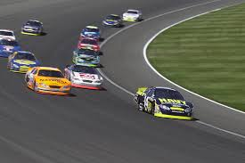
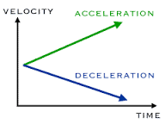
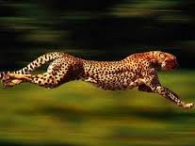
Velocity (Speed)

Slide 2
Average Speed (V_{av}) – the total distance divided by the total time for a trip
V_{av}
Delta (∆) – “change in”
∆d – change in distance ∆d = d_{f} - d_{i}
∆t – change in time ∆t = t_{f} - t_{i}

Slide 3
Instantaneous Speed – the speed at which an object is traveling at a particular instant in time
Constant Speed – Uniform Motion

Slide 4
Calculating Average Speed
When solving problems, GUESS:
G iven – Write down all knowns (with units)
U nkown – Write what you’re trying to find
E quation – Write down the formula to be used
S olve (plug in) – Fill in your formula with knowns (including units)
S olution (units & SF) – Write the answer with units AND proper sig figs

