Slide 1
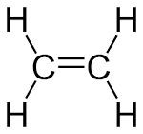
Alkenes
Alkenes are Unsaturated hydrocarbons
They contain at least one Double Bond between carbon atoms. (Because of this, there is no such thing as a 1-carbon alkene)
The general formula for alkenes is C_{n}H_{2n}
The smallest alkene has 2 carbon atoms double bonded together.

Slide 2
The prefixes for the number of carbon atoms is the same as with alkanes
Number of Carbons | Prefix
1 | Meth
2 | Eth
3 | Prop
4 | But
5 | Pent
6 | Hex
7 | Hept
8 | Oct
9 | Non
10 | Dec

Slide 3
Naming Alkenes
Rule 1: Similar to naming alkanes but change the suffix to –ene
Number of Carbons | Prefix | Name with -ene
1 | Meth | Methene
2 | Eth | Ethene
3 | Prop | Propene
And so on….

Slide 4
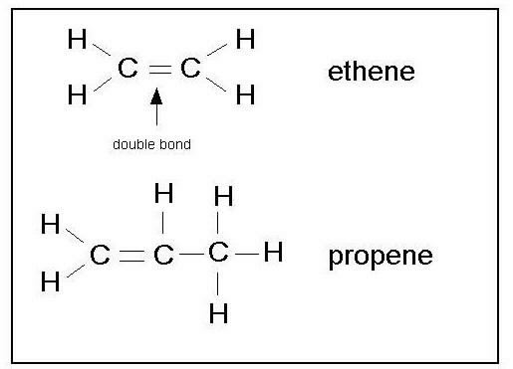
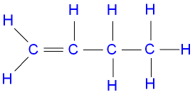
Rule 2: Number the carbons in the parent chain so that the double bond gets the LOWEST number.
(Ethene and propene do not have a prefix because there is only 1 place the double bond can be.)
1 2 3 4

Slide 5
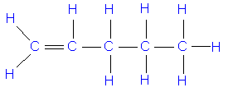
Rule 3: An alkene with 4 or more carbons also needs a number specifying where the double bond is located on the chain.
1 2 3 4 5
1- Pentene

Slide 6
Rule 4: Cyclic alkenes are named in much the same way except carbon number 1 MUST be one of the carbons connected by the double bond
cyclopentene

Slide 7
Naming Branched Alkenes
Follow the same rules as branched-chain alkanes except:
Rule 1: The parent chain is always the longest chain that contains the DOUBLE BOND, whether or not that is the longest carbon chain.
Rule 2: The position of the Double Bond (NOT the branches) determines the way the chain is numbered.

Slide 8
Rule 3: If an alkene chain has more than one double bond, the number of double bonds is shown by using a prefix before the suffix -ene.
Rule 4: The chain is numbered to give the lowest set of numbers.
2, 4 – heptadiene

Slide 9
Let’s Practice…

Slide 10
Draw: 1,3-pentadiene
Draw: 2-methyl-1,3-butadiene

Slide 11
Alkynes
Alkynes are unsaturated hydrocarbons that contain at least one Triple Bond between carbon atoms.
The simplest alkyne is ethyne (C₂H₂), more commonly known as acetylene
Alkynes with one triple bond have the general formula of C_{n}H_{2n-2}

Slide 12
Naming and Drawing Alkynes
Naming is the same as alkenes except the suffix is -yne instead of -ene.

Slide 13
Let’s Practice…

Slide 14
Draw: 4-methyl-2-pentyne

