Slide 1
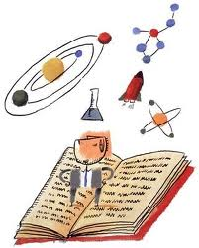
Science 30 – Atom Review

Slide 2
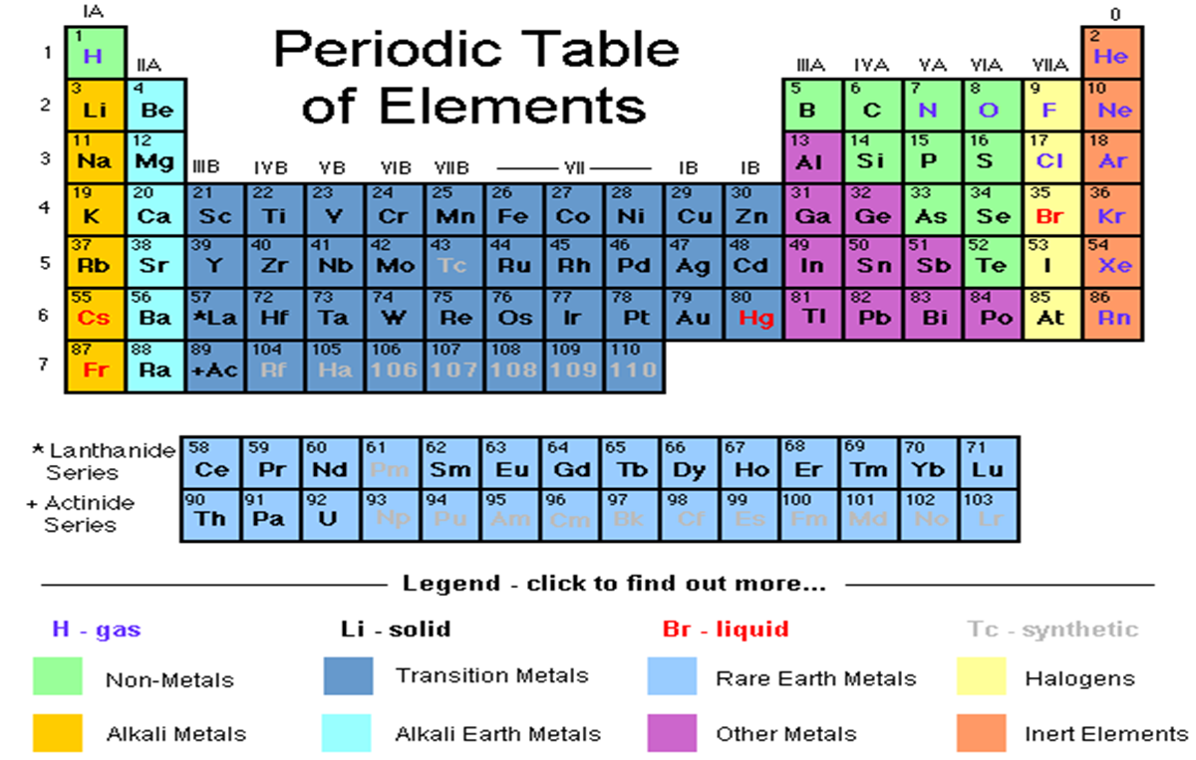

Slide 3
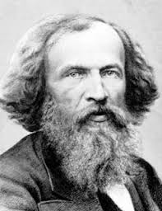
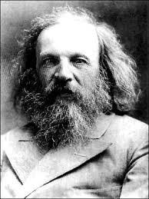
The first version of the periodic table was created by a Russian scientist, Dmitri Mendeleev in the 1860’s.

Slide 4
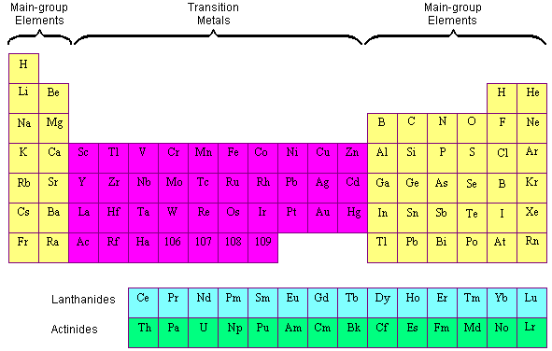
Main Parts of the PTE:

Slide 5
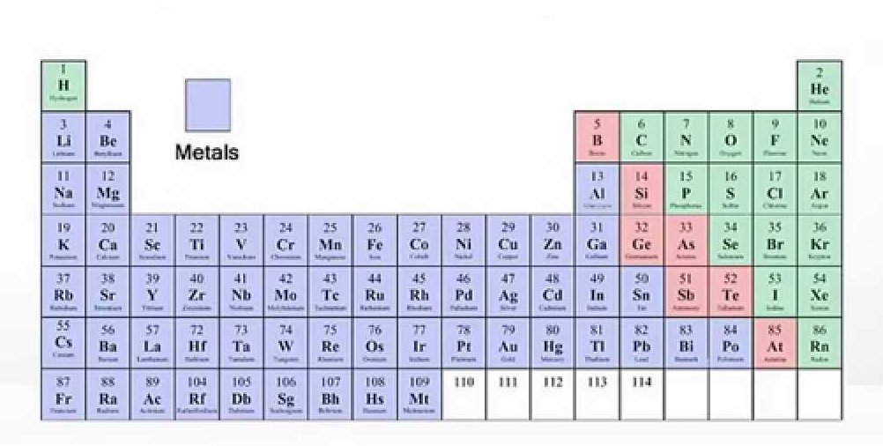
Metals, Non Metals & Metalloids:
Metals: found to the left of the “ladder” generally shiny solids and good conductors
Notes:
The position of elements in the periodic table provides hints about the types of compounds they form.

Slide 6
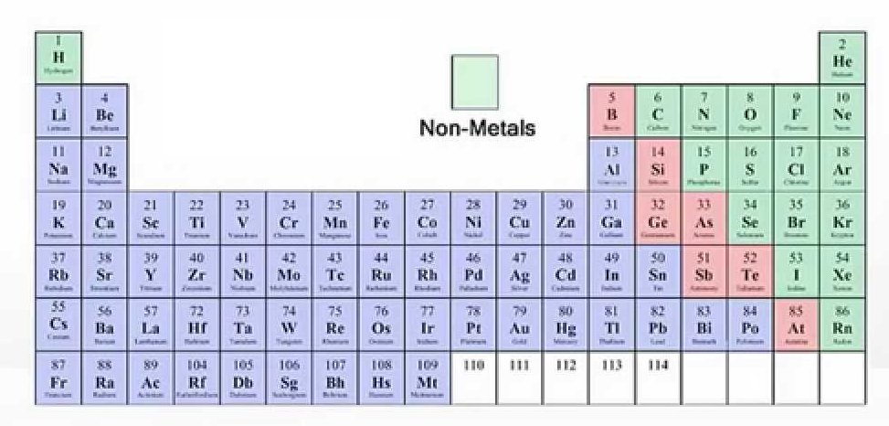
Non-Metals: found to the right of the “ladder” exist in all three states of matter.
These elements are dull, mostly insulators

Slide 7
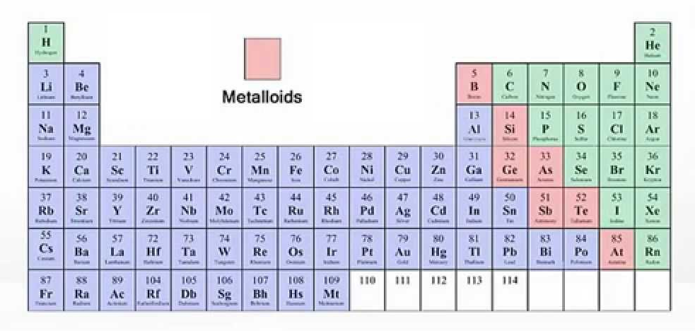
Metalloids: found along both sides of the “ladder”
have properties of both metals and non-metals

Slide 8
Horizontal rows are called periods.

Slide 9
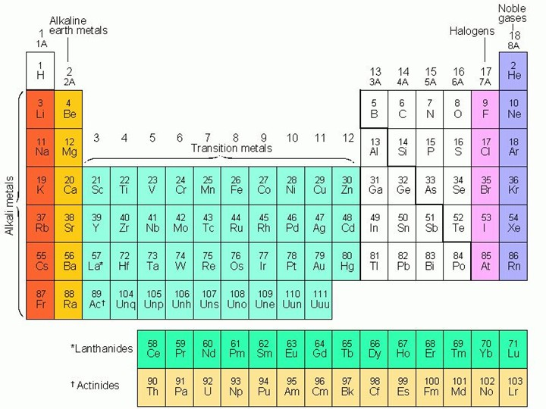
Vertical columns are called groups or families.
These families tend to have similar physical and chemical properties.

Slide 10
Chemical families:
- alkali metal (Group 1)
- alkaline earth metals (Group 2)
- noble gases (Group 18)
- halogens (Group 17)

Slide 11
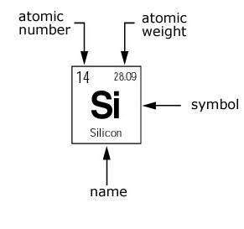
How to read the Periodic Table:
# of protons =
= # of protons + neutrons

Slide 13
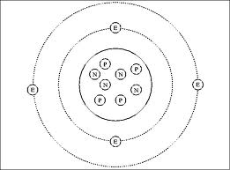
Structure of the Atom
Electron
Nucleus
Proton
Neutron

Slide 14
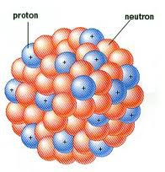
Structure of the Atom
Nucleus - at the centre of an atom, almost all of the mass in an atom is held here and is made up of the protons and neutrons

Slide 15
Subatomic Particles:
2. Neutron - a neutral particle found in the nucleus of an atom
3. Proton: a positively charged particle that is found in the nucleus of an atom.
4. Electron: a negatively charged particle that moves around the nucleus of an atom at different energy levels or orbits

Slide 16
How Many Subatomic Particles in Each Element?
Atomic Number
Atomic Mass

Slide 17
How Many Subatomic Particles in Each Element?
Atomic Number - the number of protons found in the nucleus of an atom
P
Atomic Mass - the sum of the number of protons and neutrons in the nucleus of an atom
P
N

Slide 18
Finding the number of Protons, Neutrons and Electrons in an Atom
Protons are equal to the Atomic Number
Protons plus neutrons are equal to the Atomic Mass
Atoms have a neutral charge. Therefore, the number of electrons (which have a NEGATIVE charge) needs to equal the number of protons (which have a POSITIVE charge).

Slide 19
Example
16
S
32.00
Find the Number of:
Protons: ____
Neutrons: ____
Electrons: ____
P = Atomic Number
N = Atomic Mass - P
E = P
16
16
16

Slide 20
Charges and Ions
1. Since electrons are constantly moving around the outside of the atom, sometimes an electron can be gained or lost.
Ion - is an atom that has gained or lost electrons.
2. When an atom gains or loses electrons, this causes the atom to have a charge
3. We can find these charges on the Periodic Table.

Slide 21
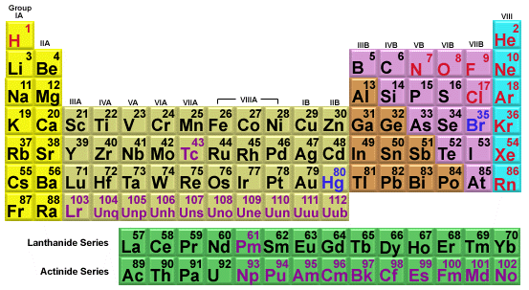
Label the Charges
+1
+2
+3
±4
-3
-2
-1

Slide 22
Representation
1. Element Symbol is written in the centre.
3. Mass Number is written to the top left,
X
4. Ionic charge is written to the top right.
2. Atomic number is written to the bottom left.

