Slide 1
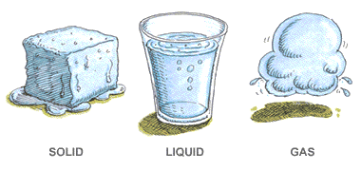
Phase Changes

Slide 2
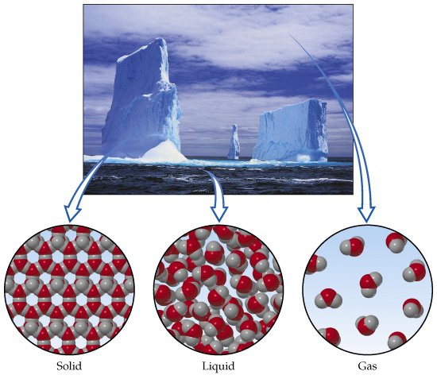
About Changes of State
In a change of state, atoms/molecules either move closer together or farther apart due to the addition or removal of heat energy.
This causes a change in the VOLUME and the STRUCTURE of the substance

Slide 3
Molecules in a Solid
Molecules are crowded together and do not move away from each other.
When they move, they wiggle in place.
As a result, they can crowd into a smaller space.

Slide 4
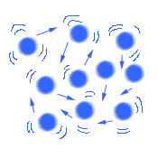
Molecules in a Liquid
In a liquid, matter can take up a bit more space than in a solid.
Because the molecules are free to move around each other, they can spread out more, but they don't go far from each other.

Slide 5
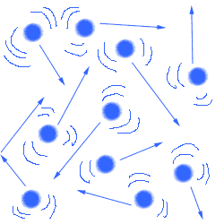
Molecules in a Gas
The molecules in a gas are moving around like crazy, bouncing everywhere.
They do not have to stay close to one another.
A gas takes up as much space as the container (tank, room, world! )

Slide 6
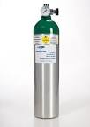
However, gas can also be squeezed, or compressed, unlike a liquid or a solid.
Ex. That is why a deep sea diver can carry enough oxygen for long dives in a tank on his back, and why a small helium tank can inflate dozens of balloons.

Slide 7
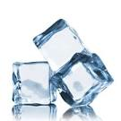
Heat and Changes of State
Lets think about this…
How do we get an ice cube to turn to liquid?
How do we get liquid (water) to turn to gas/vapour?

Slide 8
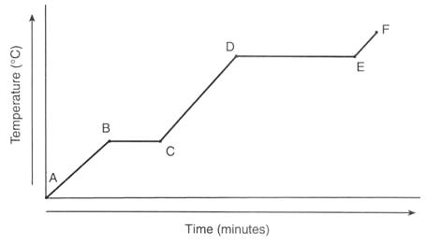
Heating curves
0

Slide 9
Analyzing a heating curve
If we examine the graph above called a heating curve, we can break it down by sections.
A-B (Solid): is where heat would be added and Q=MCΔT would be used.
C-D (Liquid): is where heat would be added and the Q=MCΔT would be used.
E-F (Gas): is where heat would be added and the Q=MCΔT would be used.
But what about the 2 other parts of the graph B-C and D- E, what is happening in those. Well we can explain those by looking at the structure of how the atoms are packed in the 3 states of matter,

Slide 10
Phase Changes
What about the 2 other parts of the graph B-C and D-E, what is happening in those?
B-C (solid-liquid): melting or fusion
D-E (liquid- gas): boiling or vaporization
These are called Phase Changes

Slide 11
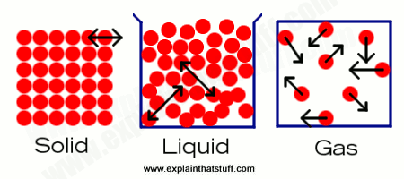
A Closer look
Atoms changing from a solid to a liquid would require a small amount of energy separate the atoms, as they do not move very far.
However, when atoms change from a liquid to a gas, they require much more energy to separate them as they move much farther apart.

Slide 12
Calculating Phase Change Energy
To calculate the energy (or heat) for these phase changes we use the following formulas:
Heat of Vaporization
Heat of Fusion
Q = MH_{f} Q = MH_{v}
**H_{f} and H_{v} these are constants that can be found in a chart

Slide 13
Example: How much heat will be needed to change 2.5 kg of ice at -30.0 C to gas at 105.0 C?

Slide 14
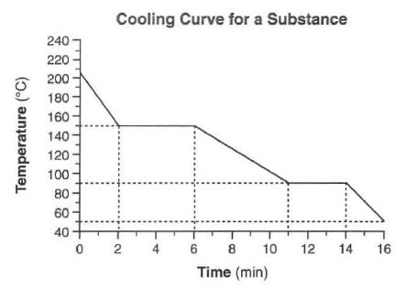
Cooling Curve
A
B
C
D
E
F

Slide 15
Analyzing a cooling curve
A-B (Gas): is where heat would be added and Q=MCΔT would be used.
C-D (Liquid): is where heat would be added and the Q=MCΔT would be used.
E-F (Solid): is where heat would be added and the Q=MCΔT would be used.

Slide 16
Phase Changes
B-C (Gas - Liquid): Condensation
D-E (Liquid - Solid): Freezing
To calculate the energy (or heat) for these phase changes we use the following formulas:
Heat of Vaporization
Heat of Fusion
Q = MH_{f} Q = MH_{v}
**H_{f} and H_{v} these are constants that can be found in a chart

