Slide 1
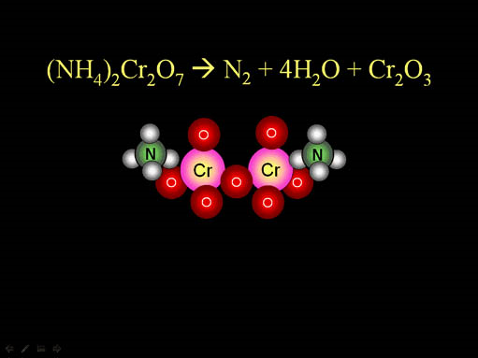
Representing and Balancing Chemical Changes

Slide 2
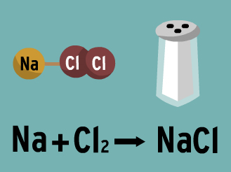
Reactants and Products
- Every chemical change contains substances that are either:
Reactants (starting materials that will react)
Products (ending materials that were made during
the reaction)
REACTANTS
PRODUCTS

Slide 3
Representations:
1. Word Equations
- When a chemical change is expressed using the chemical names of the reactants and products
Example:
Magnesium burns in oxygen to produce magnesium oxide.
Magnesium
Oxygen
Magnesium Oxide
The reaction is indicated by a ‘ → ’ sign

Slide 4
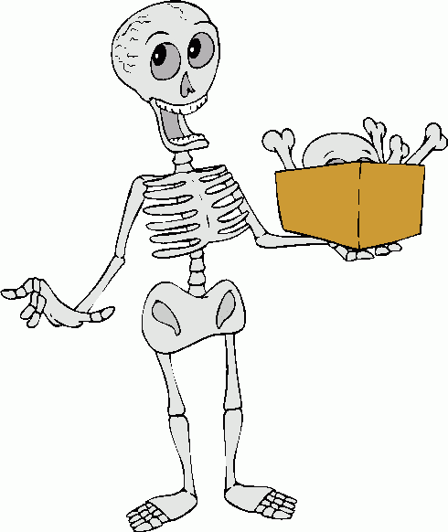
2. Skeleton Equation
(molecular or formula eq’n)
- When a chemical change is expressed using the chemical formulas of the reactants and products
Example:
Magnesium burns in oxygen to produce magnesium oxide.
Mg
O₂
MgO

Slide 5
3. Balancing Chemical Reactions
- An equation in which the reactants and products contain equal number of atoms of each type
2Mg
O₂
2MgO
COEFFICIENT
You can ONLY add a coefficient INFRONT of the molecules or compounds!

Slide 6
Steps for Balancing Chemical Eqn’s:
Write the skeleton equation
Make a list of elements and polyatomic ions in the reactions
Count and indicate the number of each type of element or polyatomic ion in the reaction
Multiply each of the formulas by the appropriate coefficient to balance the number of atoms.
HOW TO BALANCE CHEMICAL EQUATIONS
Note: balance elements that appear only once on the reactants and products sides first. Leave H and O for last.

