Slide 1
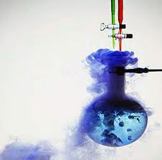
Chemical
Reactions

Slide 2
Physical Change
- a change in the size or form of a substance, which does not change the chemical properties of the substance
Example:
Ripping Paper

Slide 3
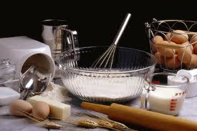
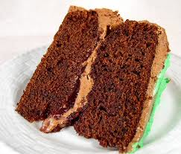
Chemical Change
- the alteration of a substance into one or more different substances with different properties
Example:
Baking
Also called a Chemical Reaction

Slide 4
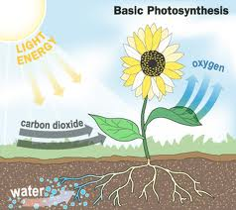
Reactions in Our World
Reactions that Help living organisms:
Photosynthesis: the process by which green pants use sunlight, carbon dioxide and water to make food and oxygen.
Reaction:
CO₂ + H₂O → O₂ + C₆H₁₂O₆

Slide 5
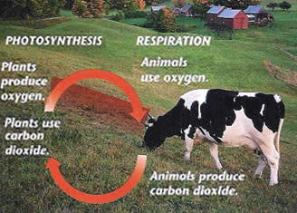
Cellular Respiration - the process by which living things generate useful energy, by combining sugars and oxygen to produce carbon dioxide and water
Reaction:
O₂ + C₆H₁₂O₆ → H₂O + CO₂
How do these chemical reactions help maintain living organisms?
Well…..

Slide 6
Chemical Reactions that are harmul to living organisms and effect the environment
Acid Rain - is a rain or any other form of precipitation that is unusually acidic, i.e. elevated levels of hydrogen ions (low pH). It can have harmful effects on plants, aquatic animals, and infrastructure through the process of wet deposition.
Reaction:
SO₃ + H₂O → H₂SO₄

Slide 7
Indicators of A Chemical Reaction
There are 5 clues
that can help identify a chemical change

Slide 8
1. Colour Change

Slide 9
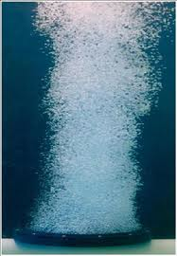
2. Gas or Bubbles are produced

Slide 10
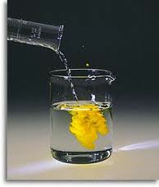
3. A Precipitate is formed

Slide 11
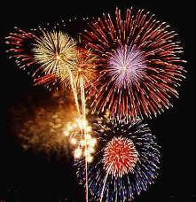
4. Heat or Light is Given Off

Slide 12
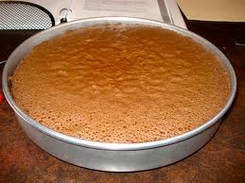
5. Difficult to Reverse

