Slide 1
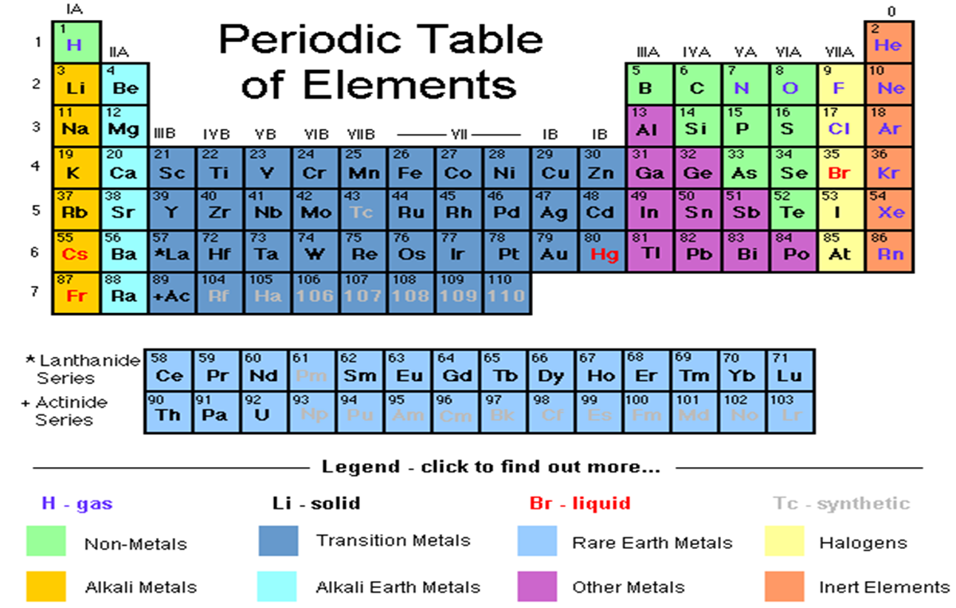

Slide 2
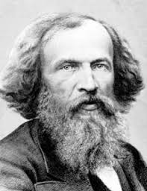
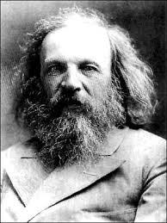
The first version of the periodic table was created by a Russian scientist, Dmitri Mendeleev in the 1860’s.

Slide 3
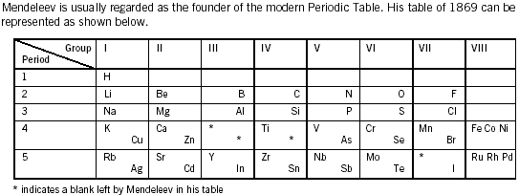
He organized his first periodic table by arranging the elements in order of increasing atomic mass.

Slide 4
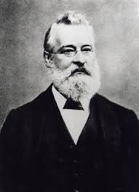
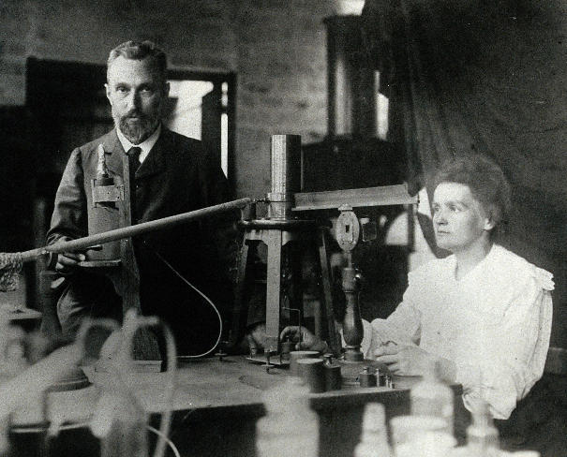
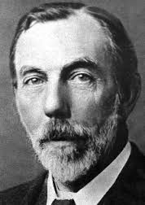
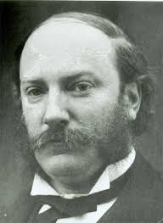
It has taken over 10 scientists over 100 years to compile the periodic table that we know today.
Pierre and Marie Curie
John Newland
Sir William Ramsey
Lord Rayleigh

Slide 5
Chemists organize the elements in a periodic table.
The elements are arranged in horizontal rows (left to right) in order
of the number of protons in their nucleus. This is the element’s
Atomic Number.

Slide 6
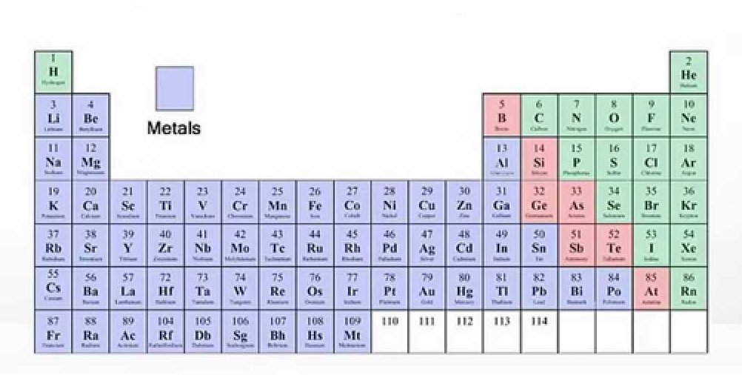
Main Parts of the PTE:
Metals: found to the left of the “ladder” generally shiny solids and good conductors
Notes:
The position of elements in the periodic table provides hints about the types of compounds they form.

Slide 7
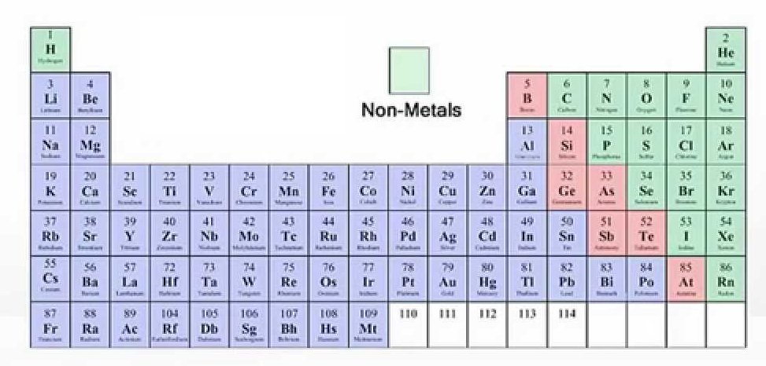
Non-Metals: found to the right of the “ladder” exist in all three states of matter.
These elements are dull, mostly insulators

Slide 8
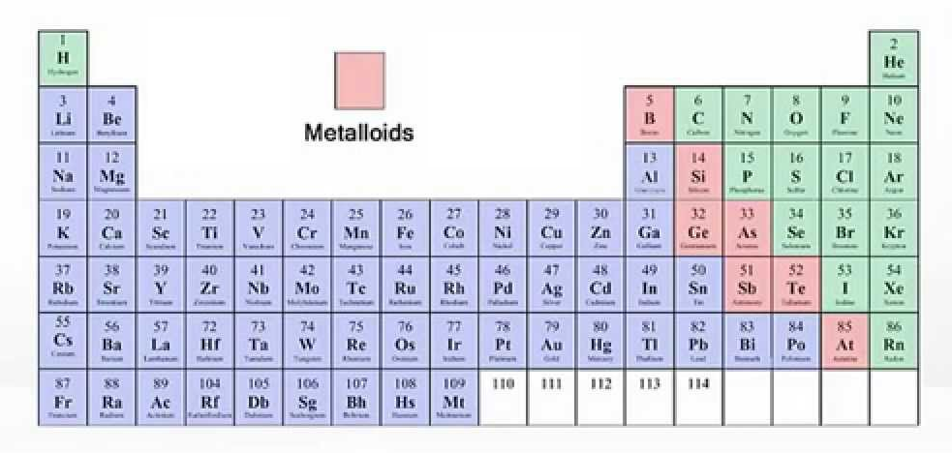
Metalloids: found along both sides of the “ladder”
have properties of both metals and non-metals

Slide 9
Horizontal rows are called periods.

Slide 10
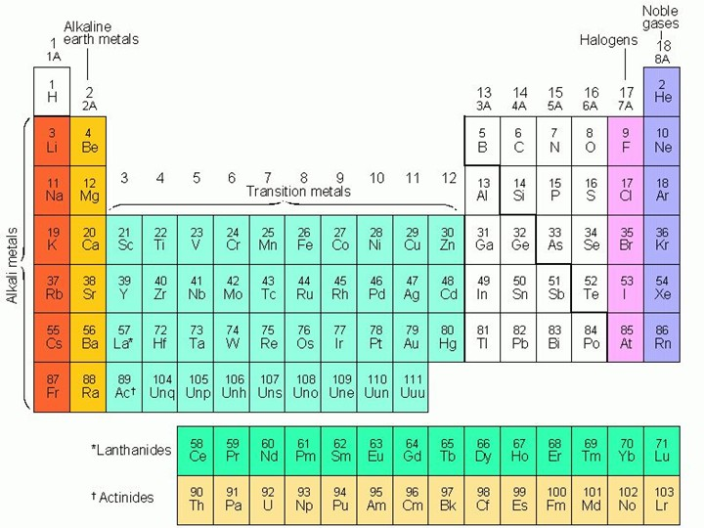
Vertical columns are called groups or families.

Slide 11
Common Elements
Memorize the following list of elements – spelling counts!
Name Symbol Name Symbol
nitrogen N carbon C
chlorine Cl potassium K
hydrogen H neon Ne
calcium Ca oxygen O
gold Au silver Ag
magnesium Mg aluminum Al
sodium Na silicon Si
sulfur S copper Cu
boron B helium He

