Slide 1
Scientific Notation
Scientists are often dealing with very very large numbers
(Ex. Distance from earth to the moon= 384 400 000m )
OR
Very very very small numbers
(Ex. 78 000 000 000 000 000 000 atoms in a grain of sand)
For this reason, we use scientific notation

Slide 2
How to Write Numbers in
Scientific Notation
Scientific Notation: N x 10e N= Number
e = Exponent
Move the decimal Right or Left until there is only 1 non zero digit before the decimal (If there is no decimal, assume it is on the end of the number)
Ex. .000345 → 0003.45
2678 → 2.678

Slide 3
2. Count the number of spaces you moved the decimal over (this will be your exponent)
Ex. .000345 → 0003.45 Moved the decimal 4
2678 → 2.678 Moved the Decimal 3
If the decimal moved right, the exponent will be negative
Ex .000345 → 0003.45 Moved the decimal 4 RIGHT, e = -4
If the decimal moved left, the exponent will be positive
Ex. 2678 → 2.678 Moved the Decimal 3 LEFT, e = +3

Slide 4
4. Plug Number and exponent into Scientific Notation Form
N x 10e
Ex .000345 → 0003.45 Moved the decimal 4 RIGHT, e = -4
Scientific Notation: 3.45 x 10⁻⁴
Ex. 2678 → 2.678 Moved the Decimal 3 LEFT, e = +3
Scientific Notation: 2.687 x 10³

Slide 5
Examples:
1) .0007896 _______________________
2) 239000 ______________________
3) 00.0034 ______________________
4) 3000000 ______________________

Slide 6
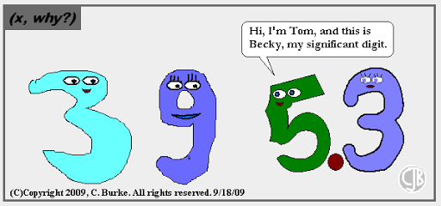
Significant Figures

Slide 7
Certainty – when measuring, record all digits that are certain plus one uncertain digit (an educated guess)
These “certainty-plus-one” digits are called Significant Figures.
1.50 in
3.60

Slide 8
Which Numbers are Significant
A. If the number has a decimal:
Start at the RIGHT of the number and begin counting at the first non zero digit
Examples:
.00456 0.7869 000.00076800

Slide 9
B. If the number DOES NOT have a Decimal
Start at the LEFT Side of the number and begin counting at the first non zero digit
Examples:
638 3400 6020

Slide 10
Rounding & Sig Figs
Determine how many sig figs you need
Round the last number based on the number directly following it (4 and under, do not round; 5 and up, round up)
Example: Round the following numbers to 3 sig figs
1. 3467 2. 00.003548 3. 324 943 000

Slide 11
Calculations and Sig Figs
Addition & Subtraction
RULE: the answer has the same number of decimal places as the measured value with the fewest decimal places.
Examples:
3.20 2
4230.789 3
+ 1.0 1
4234.989
4235.0 1 decimal place
24.00 + 62.453 + 14.23 =

Slide 12
Multiplication & Division
When multiplying and/or dividing, the answer has the same number of sig fig’s as the measurement with the fewest number of sig figs
Least Sig Fig Rule
Examples:
3.65 x 6.0 = 21.9
32.69/2.11 = 15.4928910
Our answer can only have 3 sig figs
So, 15.5 is the final answer
Our answer can only have 2 sig figs
So, 22 is the final answer

Slide 13
Converting Units –
Dimensional Analysis
You may have to switch from one set of units to another. For example, switching from meter to kilometers or hours to seconds
Given Units x Units Wanted = Answer in Units Units Have Wanted

Slide 14
Example:
Convert 3500 seconds into hours
Conversion Factor: 3600s = 1 hr or 3600 or 1hr
1hr 3600s
Given Units x Units Wanted = Answer in Units Units Have Wanted
3500 s x 1 hr = 0.97hr
3600s

