Slide 1
Thermal Expansion
Thermal expansion: is the tendency of matter to change in shape, area, and volume in response to a change in temperature, through heat transfer.
Essentially, as objects heat up, they expand, as objects cool down they contract

Slide 2
How is this Applied?
Materials expand or contract when subjected to changes in temperature.
Most materials expand when they are heated, and contract when they are cooled.
When free to deform, concrete will expand or contract due to fluctuations in temperature.
The size of the concrete structure whether it is a bridge, a highway, or a building does not make it immune to the effects of temperature.

Slide 3
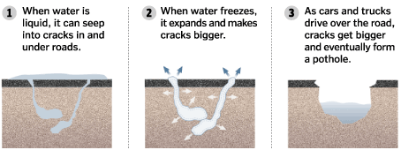
Example: Potholes
They are caused by the expansion and contraction of ground water after the water has entered into the ground under the pavement.

Slide 4
Example: Construction Design
Most large bridges include expansion joints.
When heat causes the bridge to expand during the sunlight hours of a hot day, the two sides of the expansion joint move toward one another
As the bridge cools down after dark, they begin gradually to retract. Thus the bridge has a built-in safety zone
Otherwise, it would have no room for expansion or contraction in response to temperature changes.

Slide 5
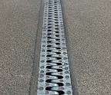

Slide 6
Linear Expansion
When building, designing and constructing large buildings, pipelines and so on, professionals need to think about the types of materials that will be best suited for the project.
One consideration is the materials
Linear Expansion

Slide 7
Linear Expansion
The change in unit length in a solid when its temperature is changed 1 degree.
For example, as it is heated, a metal rod or beam will increase its length by an amount ∆L.
ΔL = αL_{o}ΔT

Slide 8
ΔL = αL_{o}ΔT
OR
∆L = α•L_{o}•(T_{f}-T_{o})
where:
α = coefficient of linear expansion with units of (°C^{‐1}, 1/°C, K^{‐1}, 1/K)
L_{o} = original length
ΔT = change in temperture (T_{f} -T_{o})

Slide 9
Each material has its own unique coefficient of linear expansion (α).
Coefficients for a variety of materials
are found in your reference sheet

Slide 10
Ex. A copper rod is 2.60 m long and initially at 21°C. The bar is heated uniformly to a temperature of 93°C.
a) What is the change in length of the bar?
b) What is the final length of the bar?

